Slide 1


Department of Computer Science and Engineering
AI ASSISTED CAREER GUIDANCE SYSTEM
Pratheepa R – 210701192
Madhumitha K – 210701141
Makesh Kumar S - 210701144

Slide 2
Abstract
This project aims at providing the best suggestions for an individual based on their skill levels. The questions for the individual would be automatically generated based on their answering capabilities, which would enable the system to judge the skills of the person, accurately. The AI model would be trained on a dataset that contains the skills as the features, and best thriving opportunity as the value to be predicted. Using the answers from the individual, the skills are analysed and the best possible suggestion is given to the user based on the knowledge of the model.

Slide 3
Existing System
Career guidance applications offer a comprehensive suite of functionalities designed to support individuals in making informed career decisions and advancing their professional journeys. These platforms typically include tools for job searching, such as aggregating job listings from various sources and providing personalized job recommendations. They also feature robust networking opportunities, allowing users to connect with professionals, mentors, and industry leaders. Detailed information about various professions, including job descriptions, salary data, and educational requirements, helps users explore potential careers.

Slide 4
Proposed System
Our approach is designed to guide you through the process of discovering suitable career paths. Initially, we gather insights into your interests and strengths by asking simple questions about your preferences and personality. Then, we assess your knowledge and skills in various subjects and areas relevant to different job roles. We analyze your responses to help us suggest careers that align with your unique profile. Whether you're just starting to explore career options or looking to make a change, our platform is here to support you every step of the way, providing guidance that's tailored to your needs and aspirations.

Slide 5
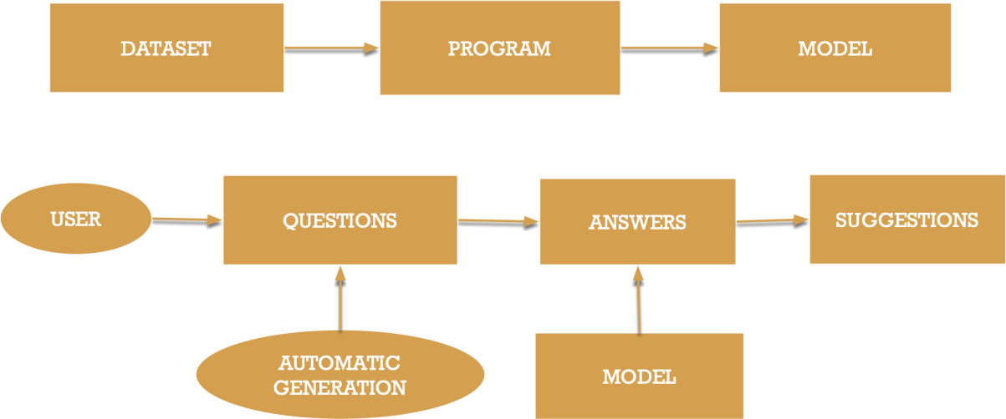
System Architecture

Slide 6
List of Modules
Dataset Collection
Profile Information
Questionnaire
Suggestions

Slide 7
Functional Description for each modules
Dataset Collection : Initially, a dataset was created which contains the details of the various skills and the suitable job role. The skill details is a feature vector which indicates the level of skills for the person in each domain. The target variable is the job title which gives the suitable job role for the person based on the skill levels. The model is trained on this dataset, and hence has the acquired knowledge.

Slide 8
Functional Description of Module
Profile Information : Using an user-friendly and a pleasant interface which has simple options and is clear, the user details such as the department and the strongholds of the user are collected. Based on the strongholds selected, a quiz is prepared which the user has to attend in order to find a suitable role for him/her.

Slide 9
Functional Description of Module
Questionnaire : A questionnaire is prepared for the user based on the strongholds chosen. It contains adaptive questions such that the difficulty level of the question is determined based on the answering capabilities of the user. The more the user answers questions correctly, the more the time the quiz would be on, and more difficult the questions would be. The quiz is designed in the form of a game fashion, which instills interest in the user.

Slide 10
Functional Description of Module
Suggestions : Based on the score obtained by the user in each of the subdomains, a feature vector is created based on the skill levels of the person. This feature vector is passed as an input to the pre-trained model, which is trained on the dataset collected using a machine learning algorithm. The model predicts a suitable job title for the user based on the input provided. The suggested job role is predicted mainly based on the skill levels of the user, and thus would be more appropriate for the user.

Slide 11

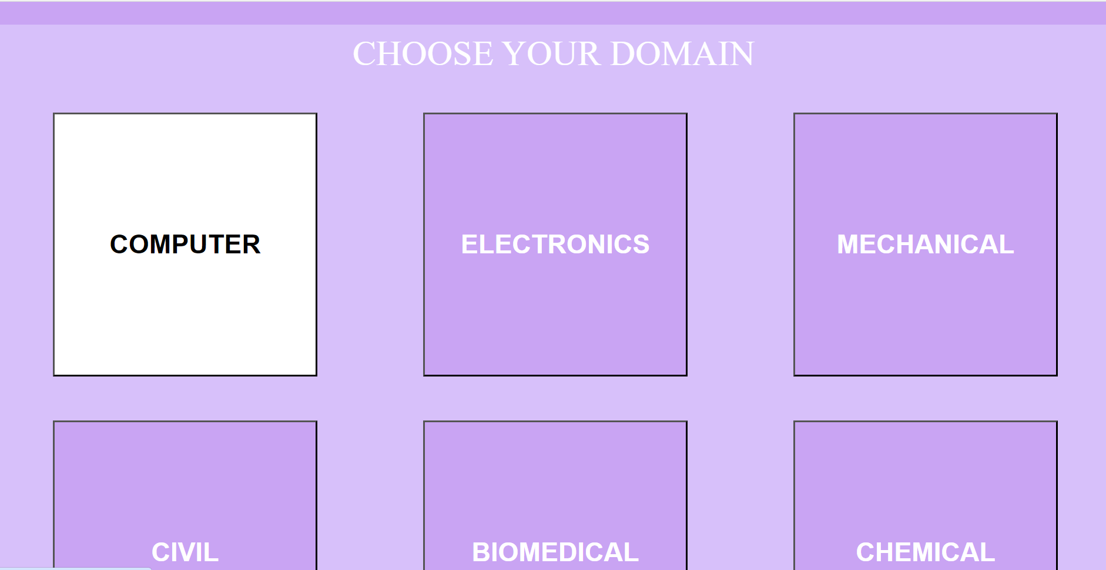
Implementation

Slide 12
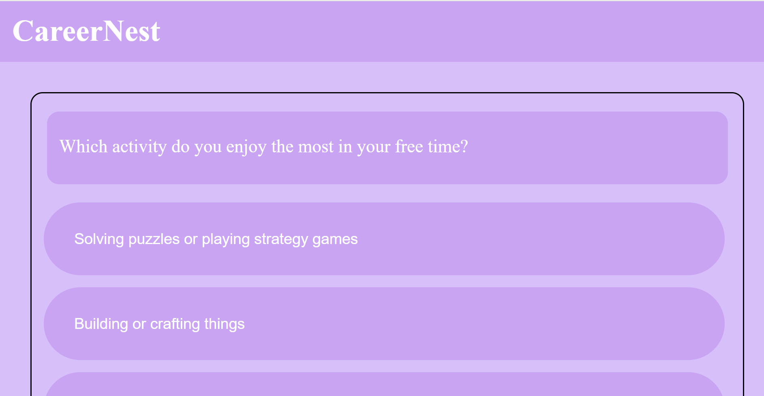
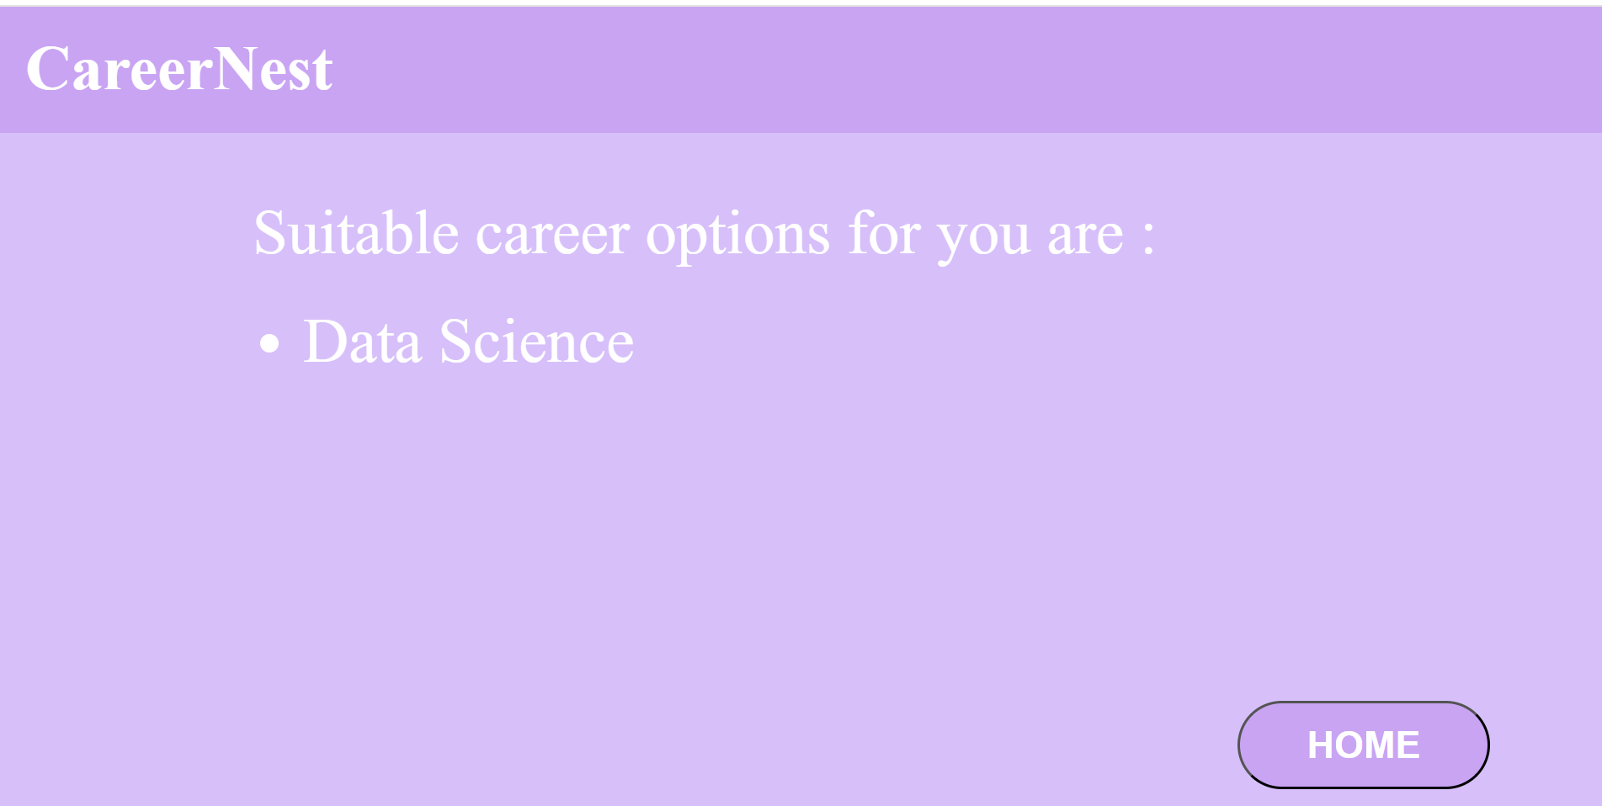
Implementation

Slide 13
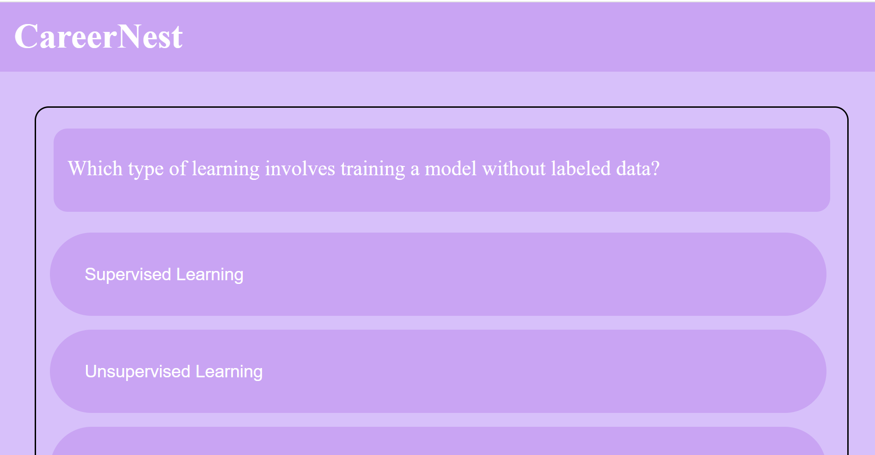
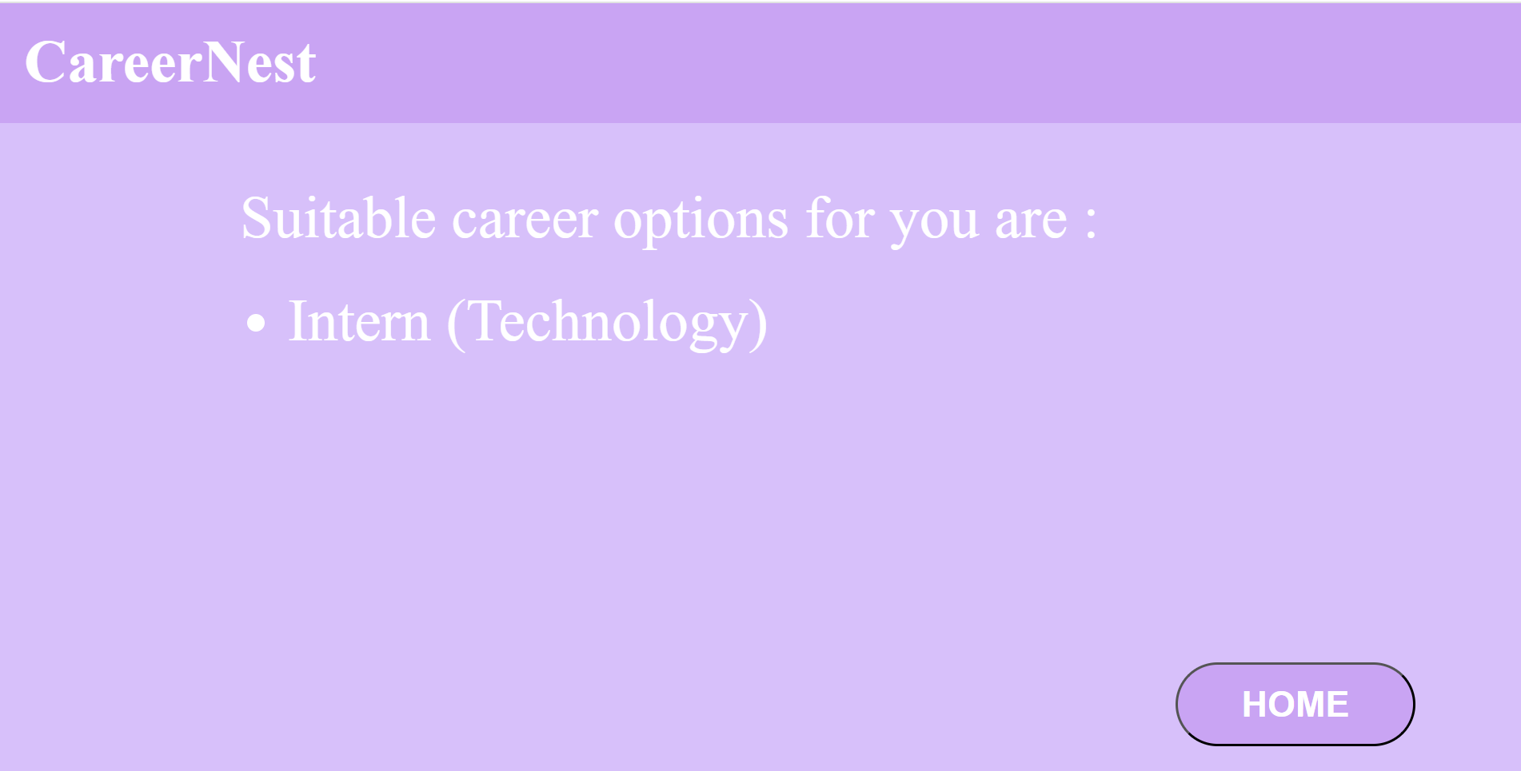
Implementation

Slide 14
Conclusion
Our career guidance system represents a significant advancement in providing personalized support to individuals navigating their career paths. Through a combination of character assessment, subject proficiency evaluation, and advanced machine learning algorithms, we have successfully empowered users to discover suitable career opportunities aligned with their unique strengths and interests. The user-friendly interface ensures accessibility for all users, while continuous refinement and optimization efforts ensure the accuracy and relevance of our recommendations.

Slide 15
Thank You

